Slide 1
ISOTOPES & Their Notation
In this PPT you will find:
A Do-NOW that will review what students learned from our PPT on Basic Atomic Structure
The solution to this Do-Now organized as a full group share out
A Whiteboard Review Game of the previous learning targets
Lesson Objectives
A walkthrough of Isotopes, their Structure, Application
A Guided Practice Activity that practices notating isotopes
An Exit Ticket that is designed to assess their grasp on the learning targets presented in the PPT

Slide 2
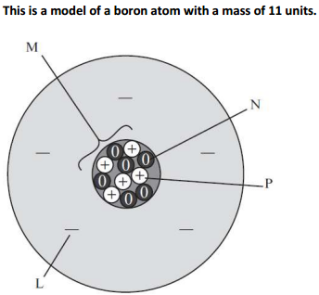
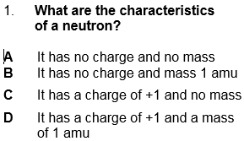
TODAY’S Do-now
M
2) WHICH particle should be REMOVED to represent a BORON atom with an Atomic mass of 10amu? Why?
N
P
L

Slide 3
LET’s GO OVER IT!
TEST TAKING 101
-I’d do PROCESS OF ELIMINATION TO ANSWER THIS!
???
Based on what you’ve learned about the mass and charges of subatomic particles
…WHICH two answer choices can be ELIMINATED?!
We should know that Neutrons do NOT have a charge of +1, so we should only pick between A & B

Slide 4
LET’s GO OVER IT!
M
2) WHICH particle should be REMOVED to represent a BORON atom with an Atomic mass of 10amu? Why?
This is STRAIGHT from an old ILLUMINATE assessment…the first thing we should do is IDENTIFY what ALL of these LABELED PARTS ARE!
N
P
L
L is…
M is…
an ELECTRON
the NUCLEUS
P is…
N is…
a PROTON
a NEUTRON

Slide 5
How do we calculate Atomic MASS?
M
2) WHICH particle should be REMOVED to represent a BORON atom with an Atomic mass of 10amu? Why?
Protons + Neutrons
N
If we take away particle L, will that change the Atomic Mass to 10?!
P
NO! Eliminate it
L
L is…
M is…
an ELECTRON
the NUCLEUS
P is…
N is…
a PROTON
a NEUTRON

Slide 6
If we take away M, will that change the Atomic Mass to 10?!
M
2) WHICH particle should be REMOVED to represent a BORON atom with an Atomic mass of 10amu? Why?
NO…It will change it to…zero ☺ Eliminate it
N
P
L
L is…
M is…
an ELECTRON
the NUCLEUS
P is…
N is…
a PROTON
a NEUTRON

Slide 7
If we take away P, will that change the Atomic Mass to 10?!
M
2) WHICH particle should be REMOVED to represent a BORON atom with an Atomic mass of 10amu? Why?
YES…It will change it to 10
N
P
But will it be a BORON atom, with a mass of 10?!?!
NO, it would be BERYLLIUM with a mass of 10…eliminate it
L
L is…
M is…
an ELECTRON
the NUCLEUS
P is…
N is…
a PROTON
a NEUTRON

Slide 8
If we take away N, will that change the Atomic Mass to 10?!
M
2) WHICH particle should be REMOVED to represent a BORON atom with an Atomic mass of 10amu? Why?
YES…It will change it to 10
5 PROTONS + 5 NEUTRONS
N
P
will it still be a BORON atom ?!?!
YES…why?
L
L is…
M is…
an ELECTRON
the NUCLEUS
P is…
N is…
a PROTON
a NEUTRON

Slide 9
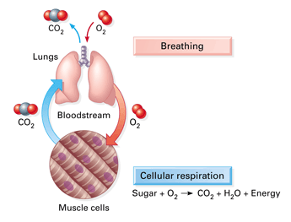
WHAT HAPPENED LAST WEEK 3?
TUESDAY 8/24 (Basic Atomic Structure)
Explain the importance of atomic structure as a system
Locate protons, neutrons in a stable and neutral atom
Differentiate between the masses of protons, neutrons, and electrons
Differentiate between atomic mass and atomic number
Identify number of protons, neutrons, and electrons using atomic number and atomic mass
3 Li
Lithium 6.947

Slide 10
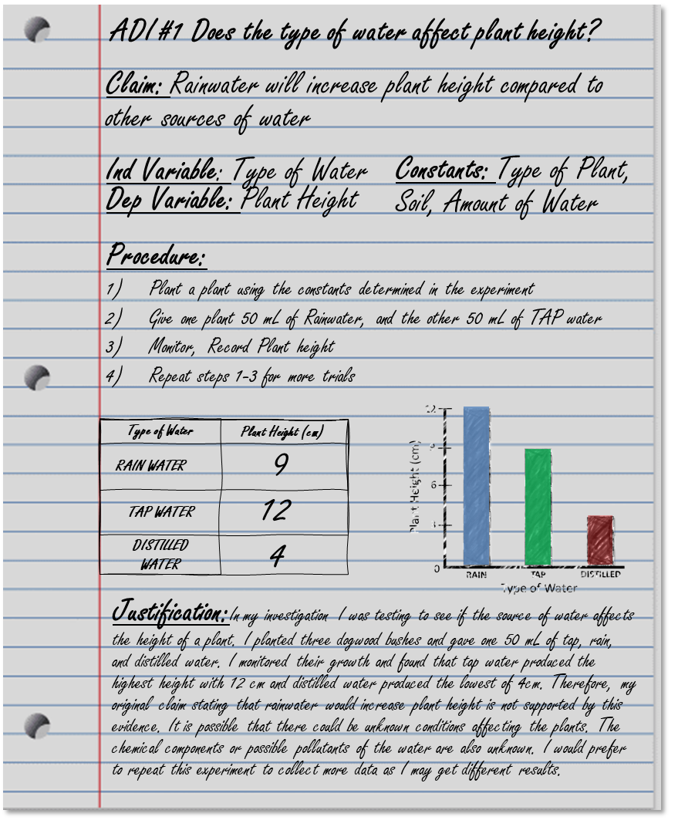
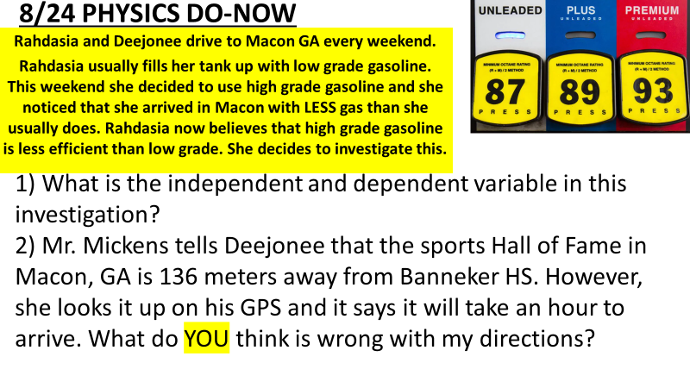
WHAT ASSIGNMENTS WERE GIVEN?
TUESDAY 8/10
- Two S.M.A.R.T Goals
FRIDAY 8/18
ADI #1 Report
ADI #1 Poster Presentation
ADI #1 Peer Review
8/12- 8/30 DO-NOWS
THURSDAY 8/26
NBC #1
Tech Signup
What Is Science?
Metric Conversions

Slide 11
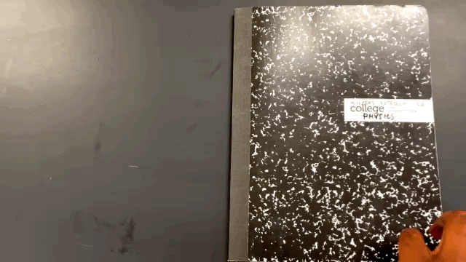
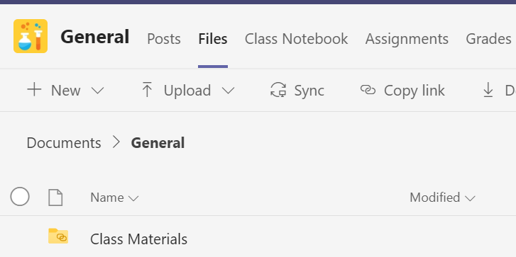
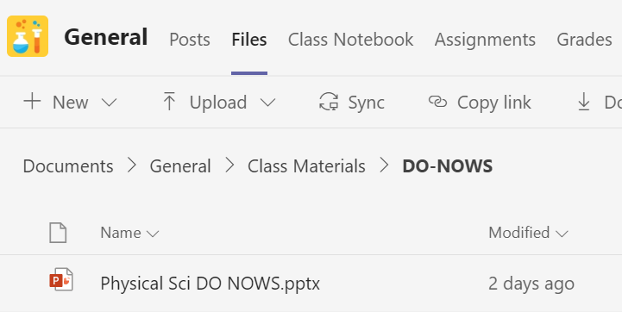
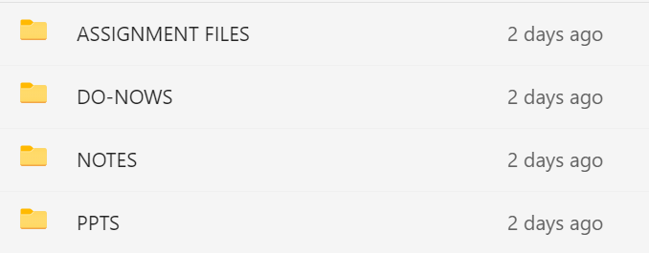
ANNOUNCEMENTS
-Missed Notebook Checks on TODAY
-Absent Do-Now process (TEAMS)
-Bring your devices EVERY DAY
Go to TEAMS>1B Physics
> Files>Class Materials> Do-NOWS>

Slide 12
UNPACKING THE STANDARD
SPS1. Obtain, evaluate, and communicate information from the Periodic Table to explain the relative properties of elements based on patterns of atomic structure.
a. Develop and use models to compare and contrast the structure of atoms, ions and isotopes.

Slide 13
WHAT YOU WILL BE ABLE To do before you leave!!!!
Explain what isotopes are and their characteristics
Notate isotopes when given a structure
List structure of an isotope when given a notation

Slide 14
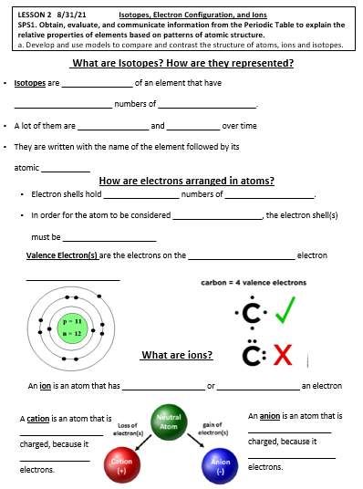
BEFORE WE START YOU SHOULD:
Make sure you have your notes & P TABLE
Put your phone up
PAY ATTENTION
PARTICIPATE!!!
These lessons BUILD up to one full conceptual understanding…don’t forget what we’ve learned…

Slide 15
WHITEBOARD REVIEW
Hold up your board when I say time!

Slide 16
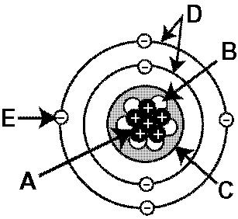
Name the part of an atom shown at part B.

Slide 17
Neutron
HOW DO YOU KNOW??

Slide 18
Name the part of an atom shown at part A.

Slide 19
Proton
How do you know?

Slide 20
Name the part of an atom shown at part E.

Slide 21
Electron
How do you know?

Slide 22
Name the part of an atom shown at part C.

Slide 23
Nucleus

Slide 24
Name the part of an atom shown at part D.

Slide 25
Shells or Orbitals

Slide 26
What am I?
I have the SMALLEST mass of the subatomic particles…and a negative charge

Slide 27
ELECTRON

Slide 28
What am I?
I have a mass of 1 amu and have NO charge

Slide 29
NeuTRON

Slide 30
What am I?
I have a mass of 1 amu and have a positive charge

Slide 31
protON

Slide 32
What am I?
I am the SUM of Protons and Neutrons in an atom

Slide 33
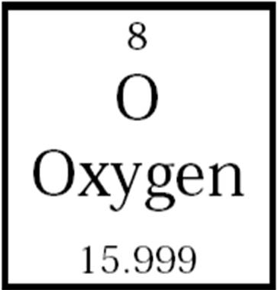
Atomic mass

Slide 34
What am I?
I am the number of protons in an atom and I determine an element’s identity

Slide 35
Atomic number

Slide 36
What am I?
I have 11 protons, 11 electrons, and 12 Neutrons

Slide 37
sodium

Slide 38
What am I?
I have 11 protons, 12 electrons, and 12 Neutrons

Slide 39
sodium

Slide 40
How many protons are in Carbon?

Slide 41
6 protons

Slide 42
How many electrons are in a neutral atom of Carbon?

Slide 43
6 electrons

Slide 44
How many NEUTRONS are in a atom of Carbon?

Slide 45
Atm Mass- Atm # = N
12-6=6
6 Neutrons

Slide 46
How many NEUTRONS are in THIS atom of Carbon?
14.03

Slide 47
Atm Mass- Atm # = N
14-6=8
8 Neutrons
14.03

Slide 48
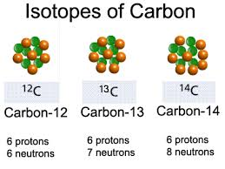
WHAT IS AN ISOTOPE?
Isotopes are atoms of an element that have DIFFERENT numbers of Neutrons.

Slide 49
WHAT IS AN ISOTOPE?
*Periodic Table shows an AVERAGE of all NATURALLY occurring isotopes of the elements

Slide 50
WHAT IS AN ISOTOPE?
*Which is why the atomic masses appear with DECIMALS

Slide 51
CHARACTERISTICS and APPLICATIONS of ISOTOPES
-A lot of them are RADIOACTIVE and DECAY over time!
(We’ll talk a LOT about this characteristic in October)

Slide 52
Turn and talk
(30 secs) What have you heard or learned about CARBON…before this class?

Slide 53
Turn and talk
SHARE OUT!

Slide 54
Turn and talk
Carbon Cycle in Bio and Env Sci
-CO2 in our bodies
CO2 in air poullution
Or the burning of FOSSIL FUELS!
CARBON IS IN ALL LIVING THINGS!

Slide 55
CHARACTERISTICS and APPLICATIONS of ISOTOPES
-Carbon-14 is used to age fossils!
-This is called CARBON DATING

Slide 56
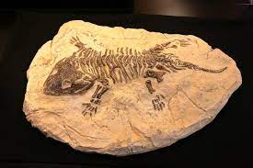
UNLIKE the most common Carbon-12
Carbon-14 decays…scientists can figure out how long the fossil has been around by measuring how much of that isotope remains in the fossil

Slide 57
HOW ARE ISOTOPES WRITTEN?
Isotopes are written with the name of the element followed by its atomic mass

Slide 58
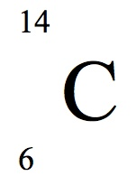
ANOTHER WAY ISOTOPES CAN BE WRITTEN

Slide 59
LET’S GO OVER WHAT WE JUST LEARNED!
Isotopes are atoms that differ in their number of _____________!
They can be ______________
and decay over time
NEUTRONS
RADIOACTIVE

Slide 60
RECAP
They are written with their element name followed by their________________!
Atomic mass
Or like this →

Slide 61
THINGS YOU NEED TO BE ABLE TO DO!
Notate isotopes when given an atomic structure
List the atomic structure when given an isotope notation
5
2 Protons
2 Electrons
3 Neutrons
Helium-5

Slide 62
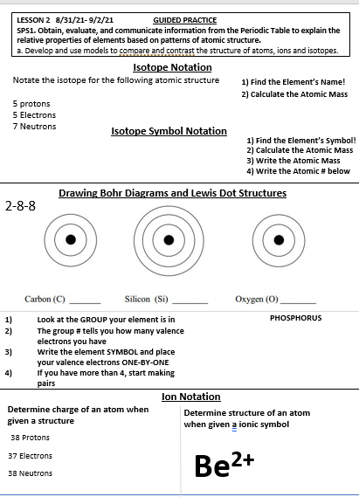
LET’S PRACTICE!
-We are on our Guided practice
-Pay attention
-We’ll be doing some together
-If you need an additional sheet of paper for more examples get it out now

Slide 63
GUIDED PRACTICE-WATCH ME!
Notate the isotope for the following atomic structure
5 protons
5 Electrons
7 Neutrons
1) Find the Element’s Name!
2) Calculate the Atomic Mass
Boron-
7+5
Boron-12

Slide 64
GUIDED PRACTICE-THE OTHER WAY!!
1) Find the Element’s Symbol!
Notate the isotope for the following atomic structure
5 protons
5 Electrons
7 Neutrons
2) Calculate the Atomic Mass
3) Write the Atomic Mass
4) Write the Atomic # below
B
7+5
12
5

Slide 65
GUIDED PRACTICE-THE OTHER WAY!!
Notate the isotope for the following atomic structure
5 protons
5 Electrons
7 Neutrons
B
12
Boron-12 or
5

Slide 66
GUIDED PRACTICE- You try it!
Notate the isotope for the following atomic structure
7 Protons
5 Electrons
5 Neutrons
1) Find the Element’s Name!
2) Calculate the Atomic Mass

Slide 67
GUIDED PRACTICE-THE OTHER WAY!!
Notate the isotope for the following atomic structure
7 protons
5 Electrons
5 Neutrons
1) Find the Element’s Symbol!
2) Calculate the Atomic Mass
3) Write the Atomic Mass
4) Write the Atomic # below

Slide 68
GUIDED PRACTICE-WRITE BOTH
Notate the isotope for the following atomic structure
3 Protons
3 Electrons
4 Neutrons

Slide 69
GUIDED PRACTICE- WATCH ME
List the atomic structure of the isotope:
Nitrogen-18
1) Find the number of Protons
2) Number of Electrons (neutral)
3) Number of Neutrons
7 protons
7 electrons
Mass of the ISOTOPE-Atomic #
18 - 7= 11
11 neutrons

Slide 70
GUIDED PRACTICE
List the atomic structure of the isotope:
Sodium-24
1) Find the number of Protons
2) Number of Electrons (neutral)
3) Number of Neutrons
11 protons
Mass of the ISOTOPE-Atomic #
24-11= 13
11 electrons
13 neutrons

Slide 71
GUIDED PRACTICE-WRITE BOTH
List the atomic structure of the isotope
O
15
8

Slide 72
Which isotope below has an atomic structure of 6 protons, 6 electrons, and 8 neutrons?
Carbon-12
Carbon-20
Carbon-14
Carbon-6

Slide 73
EXIT TICKET
Chlorine-35
Isotopes are atoms that differ in their number of _______________.
True or False. Isotopes are never radioactive.
Notate the isotope that has 9 protons, 9 electrons, and 10 neutrons. (both notations)
List the structure of the isotope in figure 1
List the structure of the isotope in figure 2
Figure 1
Cu
65
29
Figure 2

