Slide 1
Chemical Reactions & Equations
In this PPT you will find:
A Do-NOW that will call on prior knowledge to connect cooking to the process of chemical reactions
The solution to this Do-Now organized as a full group share out
Lesson Objectives
A walkthrough of chemical reactions, equations, and balancing equations
An Exit Ticket that is designed to assess their grasp on the learning targets presented in the PPT

Slide 2
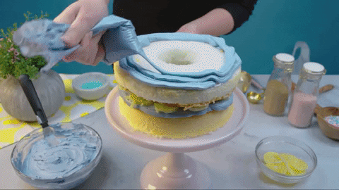
PHYS SCI DO-NOW
Jasmine is baking a cake.
What ingredients does she need?
What actions does she need to perform in order to bake this cake?
If she measured the mass of the ingredients then measured the mass of the cake after she finished, Would the mass be the same? Explain why or why not.

Slide 3
PHYSICAL SCIENCE DO-NOW
H₂O
Cl₂
HCl
2
2
4
O₂
+
+
What is the difference between a molecule and a compound?
Which substance(s) above are NOT compounds, but molecules? Why?
Is Cl₂ a REACTANT or a PRODUCT? How do you know?
How MANY molecules of Cl₂ are present?
How many ATOMS of Chlorine are present in those molecules?

Slide 4
2) Which substance(s) below are NOT compounds? Why?
What is the difference between a molecule and a compound?
H₂O
Cl₂
+
O₂
+
HCl
MOLECULES
COMPOUNDS
Everything up here is a MOLECULE…
Two or more atoms of different elements bonded together
Two or more atoms bonded together
But only TWO of them are COMPOUNDS…

Slide 5
2) Which substance(s) below are NOT compounds? Why?
Cl₂
O₂
and
Are NOT compounds because…
they don’t contain different elements
H₂O
HCl
Are compounds AND molecules

Slide 6
This is a CHEMICAL EQUATION…
H₂O
Cl₂
HCl
O₂
2
+
2
4
+
Its showing us the process of a CHEMICAL REACTION…where the MOLECULAR STRUCTURE of a substance is REARRANGED

Slide 7
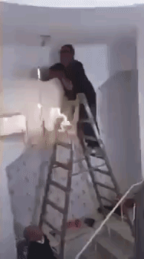
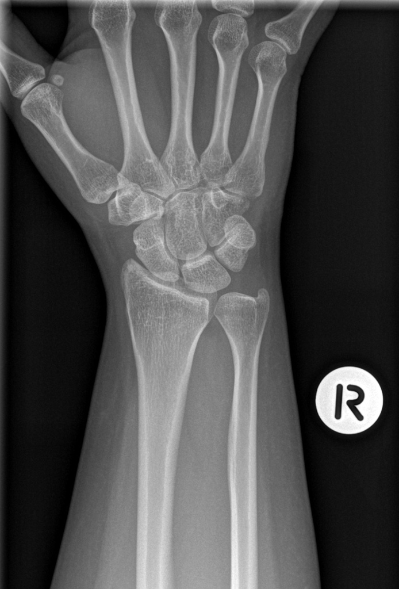
We know systems have STRUCTURE…
I interacted with a ladder…and the ground…and the SKELETAL STRUCTURE of my WRIST…was REARRANGED

Slide 8
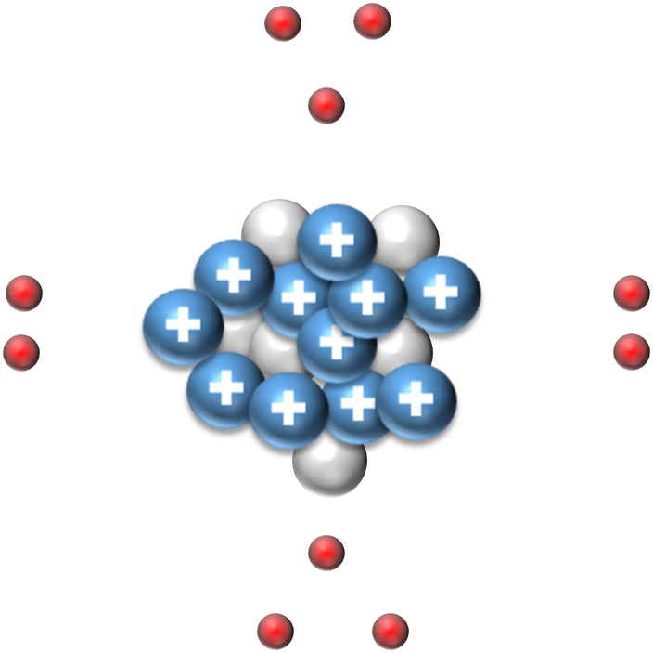
You can put an atom of SODIUM near a CHLORINE atom
+
-
And their ATOMIC STRUCTURE will be REARRANGED
Na
Cl

Slide 9
A CHEMICAL REACTION…
Involves MOLECULES interacting…and then their structures are…
REARRANGED!

Slide 10
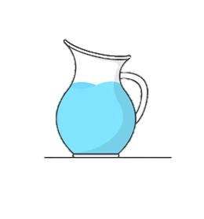
A CHEMICAL EQUATION…has TWO sides
REACTANTS
PRODUCTS
3) Is Cl₂ a REACTANT or a PRODUCT? How do you know?
H₂O
Cl₂
HCl
O₂
2
2
4
+
+
Cl₂ is a reactant because the equation STARTS with it/it’s on the left side of the arrow

Slide 11
A CHEMICAL EQUATION…
H₂O
Cl₂
HCl
O₂
2
2
4
+
+
Water
reacted with Chlorine Gas
And produced (or yielded)
Hydrogen Monochloride
and Oxygen gas
Tells the story of what happened…
Read it from LEFT to RIGHT

Slide 12
And that’s exactly what happened!
Water reacted with chlorine gas to produce hydrogen monochloride and oxygen gas!

Slide 13
A CHEMICAL EQUATION…
Except this equation is actually more SPECIFIC than that…
How so?....
H₂O
Cl₂
HCl
O₂
2
2
4
+
+
Water
combined with Chlorine Gas
And produced (or yielded)
Hydrogen Monochloride
and Oxygen gas
Its also telling us HOW MANY molecules are present!
Tells the story of what happened…
Read it from LEFT to RIGHT

Slide 14
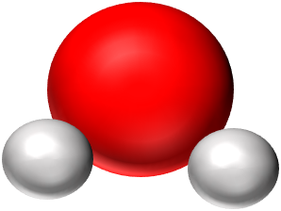
What does this mean?
What does THIS mean?
H₂O
H₂O
2

Slide 15
2
H₂O
COEFFICIENT
SUBSCRIPT
The coefficient gets applied to the ENTIRE formula
-This means that there are 2 molecules of water present!

Slide 16
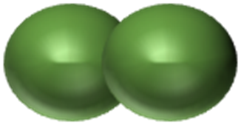
A CHEMICAL EQUATION…
H₂O
Cl₂
HCl
O₂
2
2
4
+
+
Water combined with chlorine gas to produce hydrogen monochloride and oxygen gas!
TWO Water molecules
combined with TWO Chlorine molecules
and produced (or yielded)
FOUR Hydrogen Monochlorides
and ONE Oxygen molecule
Tells the story of what happened…
…sooo what REALLY happened?!

Slide 17
4) How many chlorine molecules are present?
TWO chlorine molecules are present in this equation
Two Water molecules combined with two chlorine molecules to produce four hydrogen monochlorides and a molecule of oxygen gas!
5) How many chlorine ATOMS are present in those molecules?
FOUR chlorine atoms are present in those molecules

Slide 18
2
H₂O
COEFFICIENT
SUBSCRIPT
The coefficient gets applied to the ENTIRE formula
To determine TOTAL number of atoms…multiply the coefficient through every atom in the formula

Slide 19
2 H₂O
The subscript only gets applied to the element that is BEFORE IT
-If there is no subscript present, it is assumed that there is only 1 atom of that element in the molecule.

Slide 20
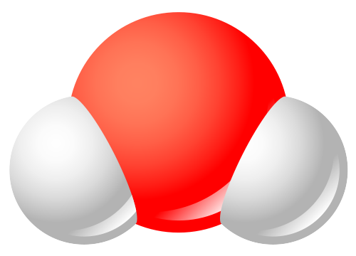
2 H₂O
How many hydrogen atoms are present?
How many oxygen atoms are present?

Slide 21
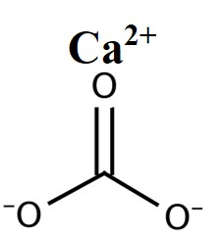
Write down symbols, multiply coefficients by subscripts
4 Ca(CO₃)
Ca
- 4
Calcium Carbonate
- 4
C
- 12
O

Slide 22
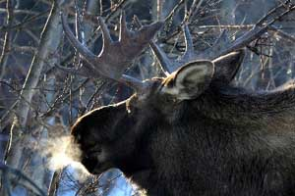
3 CO₃

Slide 23
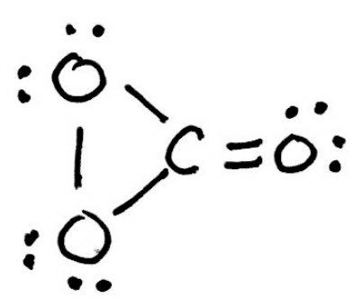
Write down symbols, multiply coefficients by subscripts
3 CO₃
- 3
C
Carbon Trioxide
- 9
O

Slide 24
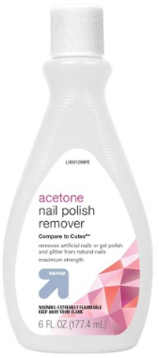
3 (C₂H₃O₂₎

Slide 25
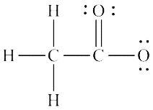
Write down symbols, multiply coefficients by subscripts
3 C₂H₃O₂
- 6
Acetate
C
- 9
H
- 6
O

Slide 26
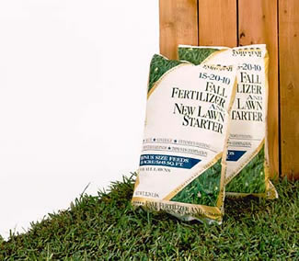
K₂(SO₄)

Slide 27
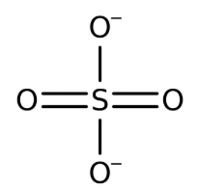
Write down symbols, multiply coefficients by subscripts
K₂SO₄
- 2
K
Potassium Sulfate
- 1
S
K--K
- 4
O

Slide 28
PHYSICAL SCIENCE DO-NOW
N₂
H₂
NH₃
+
How many Nitrogen atoms are in the REACTANTS?
How many Nitrogen atoms are in the PRODUCT?
How many Hydrogen atoms are in the REACTANTS?
How many Hydrogen atoms are in the PRODUCT?
Are there coefficients present in the equation above?

Slide 29
WHAT HAPPENED LAST WEEK 13?!
MONDAY 11/1 (ADI #2)
Explain the process of chemical reactions and how they are represented by chemical equations
Identify reactants and products in a chemical equation
WEDNESDAY 11/3 (ADI #2 Pt 2)
Differentiate between compounds and molecules
Count atoms in a chemical equation
CaF₂ + Li₂O₄ → CaO₄ + LiF

Slide 30
UNPACKING TODAY’S STANDARD
SPS3. Obtain, evaluate, and communicate information to support the Law of Conservation of Matter.
a. Plan and carry out investigations to generate evidence supporting the claim that mass is conserved during a chemical reaction.

Slide 31
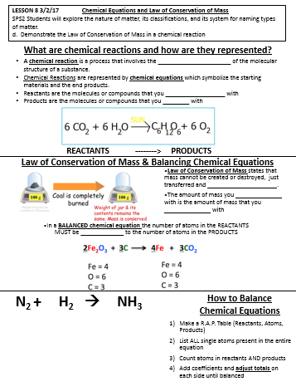
Before We Start, You Need:
Your Attention
Your Focus
Your new Notes

Slide 32
Will it stay here forever?

Slide 33
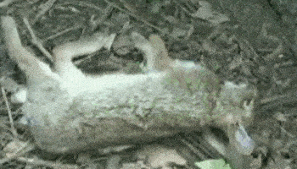

Slide 34
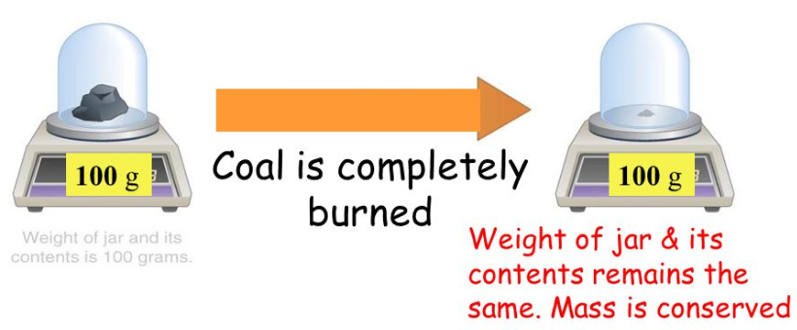
Law of Conservation of Mass
Law of Conservation of Mass states that mass cannot be created or destroyed, just transferred and REARRANGED.
The amount of mass you START with is the amount of mass that you END with

Slide 35
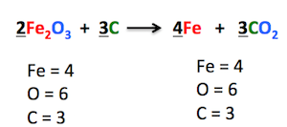
In a BALANCED chemical equation the number of atoms in the REACTANTS MUST be EQUAL to the number of atoms in the PRODUCTS
Is this equation BALANCED?

Slide 36
I-DO! (This is NOT on your PAPER)
Make a R.A.P. Table
(Reactants, Atoms, Products)
2) List ALL single atoms present in the entire equation
3) Count atoms in reactants AND products
4) Add coefficients and adjust totals on each side until balanced
P₄ + Br₂ → PBr₃

Slide 37
WE DO! GUIDED PRACTICE
Make a R.A.P. Table
(Reactants, Atoms, Products)
2) List ALL single atoms present in the entire equation
3) Count atoms in reactants AND products
4) Add coefficients and adjust totals on each side until balanced
N₂ + H₂ → NH₃

Slide 38
WRITE THIS DOWN AND TRY IT!
LiCl + Br₂ → LiBr + Cl₂

Slide 39
WRITE THIS DOWN AND TRY IT!
CaC₂ + H₂O → C₂H₂ + Ca(OH)₂

Slide 41
WRITE THIS DOWN AND TRY IT!
Balance the following equations, if necessary.
1) AlBr₃ + K → KBr + Al
2) P₄ + 6 Br₂ → 4 PBr₃

Slide 42
PHYSICAL SCI EXIT TICKET
Balance the following equations, if necessary.
1) AlBr₃ + K → KBr + Al
2) P₄ + 6 Br₂ → 4 PBr₃
3) Go to MS TEAMS open the PPT that says Guided LAB & NOTES
4) You are to open the PPT, READ and FOLLOW ALL INSTRUCTIONS ON EVERY SLIDE
You WILL NOT get your materials until I CHECK YOUR:
EXIT TICKET
PRE LAB QUESTIONS
your LAB REPORT is complete up to the DATA TABLE

