Slide 1
IONS & Their Notation
In this PPT you will find:
A Do-NOW that will review what students learned from our PPT on Electron Arrangement and Basic Atomic Structure
The solution to this Do-Now organized as a full group share out
Lesson Objectives
A walkthrough of Ions, their Structure
A Guided Practice Activity that practices notating ionic charge
An Exit Ticket that is designed to assess their grasp on the learning targets presented in the PPT

Slide 2
PHYSICAL SCIENCE DO-NOW
Mr. Mickens asked a student to write down 5 FACTS about the two atoms shown on the screen, here’s their paper:
ATOM B
ATOM A
1. ATOM A is a BORON atom because it has 5 Valence Electrons
2. ATOM B is an OXYGEN atom because it has 8 Electrons
3. Each Atom has an Atomic Mass of 14
4. Both Atoms have the same number of neutrons, so they are different ISOTOPES
5. ATOM B is NEGATIVELY charged because it has more ELECTRONS than PROTONS
1) THREE statements they made are FALSE…IDENTIFY the statements that are FALSE and explain WHY they’re false.

Slide 3
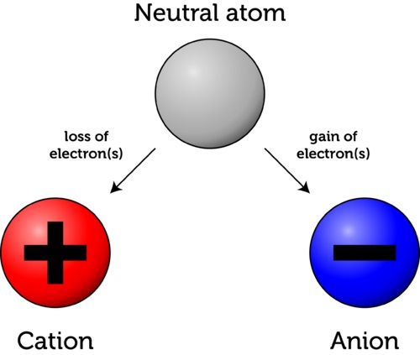
WHAT YOU SHOULD LEARN TODAY:
Describe what ions are
Differentiate between cations and anions
Determine the specific charges of ions
List structures when given charges of ions
Be²⁺
Cl⁻

Slide 4
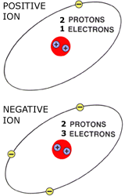
WHAT IS AN ION?
An ion is an atom that has gained or lost an electron.

Slide 5
How many electrons would we need for this to be NEUTRAL?

Slide 6
It would need to have 2 ELECTRONS to balance out the charge

Slide 7
CQ #1
What atom is this?

Slide 8
BONUS
HELIUM

Slide 9
CQ #2
What is INACCURATE about this picture?

Slide 10
CQ #2
Wouldn’t have 3 electrons on one shell

Slide 11
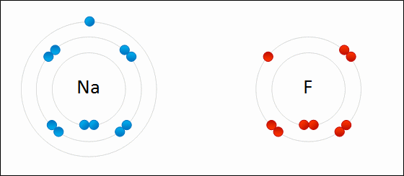
WHY is sodium becoming POSItive???
TABLE TALK
WHY is fluorine becoming negative???

Slide 12
WHAT IS A CATION?
A CATION (+) is an atom that is POSITIVELY charged…

Slide 13
WHAT IS A CATION?
…because it LOST electrons.
(losing negativity in your life…)

Slide 14
WHAT IS An ANION?
An ANION (-) is an atom that is NEGATIVELY charged…

Slide 15
WHAT IS AN anION?
Because it GAINED electrons.
(Increasing number of negative people in your life)

Slide 16
RECAP

Slide 17
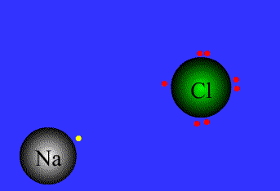
WHICH IS THE CATION?
SODIUM (Na)! Why?

Slide 18
WHICH IS THE anION?
CHLORINE (Cl)! Why?

Slide 19
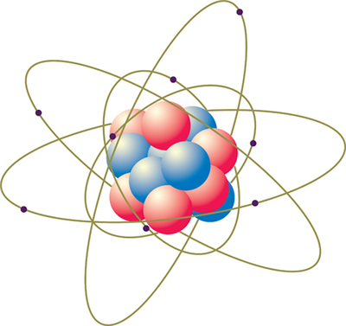
I DO!- Determine charge of an atom when given a structure
1) Find the Element’s Symbol
2) Calculate the Charge
Charge= Protons- Electrons
3 Protons
2 Electrons
4 Neutrons
9 Protons
10 Electrons
10 Neutrons
11 Protons
10 Electrons
12 Neutrons
Cation or Anion?
_________
Cation or Anion?
_________
Cation or Anion?
_________

Slide 20
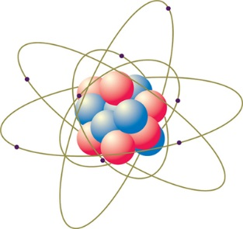
GUIDED PRACTICE- Determine charge of an atom when given a structure
Charge= Protons- Electrons
1) Find the Element’s Symbol
2) Calculate the Charge
Charge= Protons- Electrons
38 Protons
37 Electrons
38 Neutrons
16 Protons
18 Electrons
10 Neutrons
4 Protons
3 Electrons
5 Neutrons

Slide 21
I DO!- Determine structure, when given charge
1) Find the # of Protons
2) Calculate the # of electrons by adding or subtracting charge
(pos, subtract)(Neg, add)
3) Calculate Neutrons
Ca²⁺
F⁻
K⁺
____Protons
____Electrons
____Protons
____Electrons
____Protons
____Electrons
Cation or Anion?
_________
Cation or Anion?
_________
Cation or Anion?
_________

Slide 22
Guided Practice!- Determine structure, when given charge
1) Find the # of Protons
2) Calculate the # of electrons by adding or subtracting charge
(pos, subtract)(Neg, add)
3) Calculate Neutrons
Be²⁺
Cl⁻
Li⁺
____Protons
____Electrons
____Protons
____Electrons
____Protons
____Electrons
Cation or Anion?
_________
Cation or Anion?
_________
Cation or Anion?
_________

Slide 23
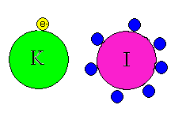
EXIT TICKET
Which is the cation in figure 1? Why?
Which is the anion in figure 1? Why?
Identify the element and its charge from the following structure:
20 Protons and 18 Electrons
4) List the structure of Mg²⁺
5) List the structure of Rb⁺

