Slide 1
EMAG SPECTRUM E-POSTER (Due 5/5)
You have been assigned a portion of the Electromagnetic Spectrum and will create an electronic poster that would inform peers about its characteristics and uses in everyday life.
THE POSTER:
-Must mention the wavelength (20)
-Must mention the Frequency (actual measurement range and low or high) (20)
-Must mention the amount of energy relative to other waves (20)
-Must mention three applications (20)
-Must have color and four pictures(20)
TOTAL(____/100)

Slide 2
YOUR ASSIGNED WAVE
INFRARED WAVES
Name- Class Period
Jasmine Stevens 6th Period
Wavelength = 3.5nm-6.9nm
Frequency=350Hz-600Hz
(3rd Lowest Frequency Range)
Relatively Low Energy,
only higher than Radio and Microwaves
APPLICATIONS
Thermal Imaging
Laser Thermometers
Remote Tech
-Must mention the wavelength (20)
-Must mention the Frequency (actual measurement range and low or high) (20)
-Must mention the amount of energy relative to other waves (20)
-Must mention three applications (20)
-Must have color and four pictures(20)
TOTAL(____/100)

Slide 3
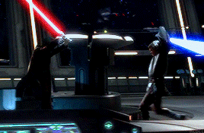
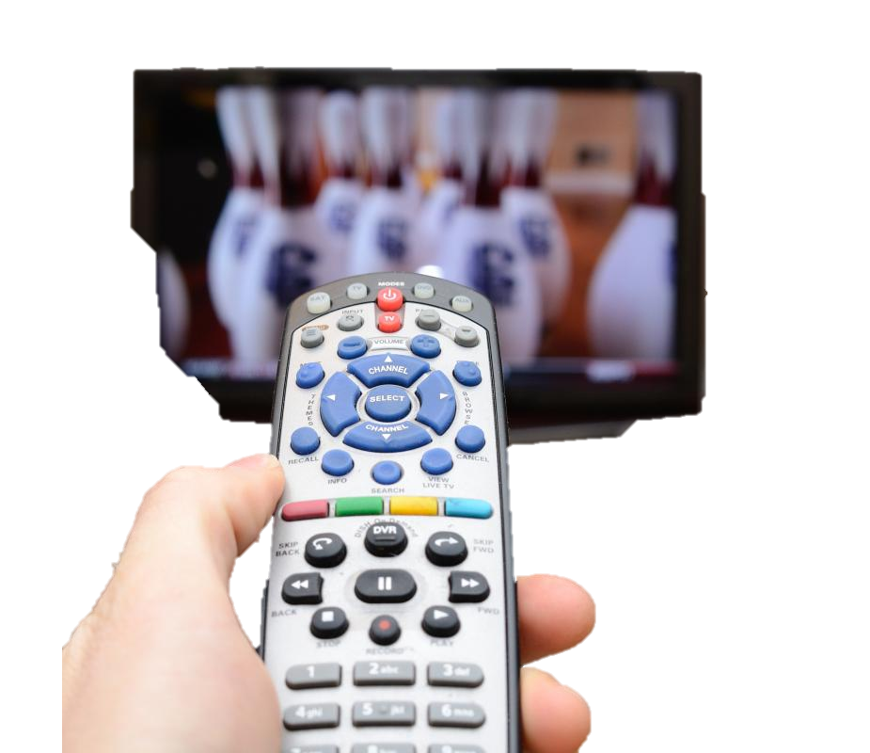
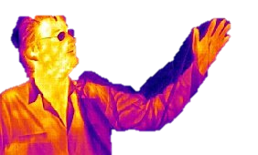
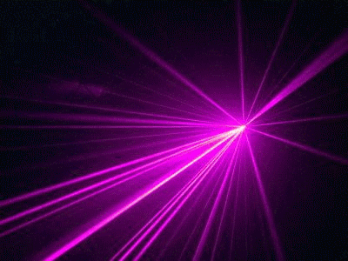
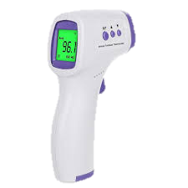
INFRARED WAVES
Jasmine Stevens 6th Period
Wavelength = 3.5nm-6.9nm
Frequency=350Hz-600Hz
(3rd Lowest Frequency Range)
Relatively Low Energy,
only higher than Radio and Microwaves
APPLICATIONS
Thermal Imaging
Laser Thermometers
Remote Tech

Slide 4
EMAG SPECTRUM E-POSTER (Due 5/5)
Kealani
Tierra
Shamar
Kenyala
Charmaine
Nysa
Camyah
Chasity
Rakesh
Mia
Mekhila
Dezmone
Emanuel
THURSDAY 5/5!
Kai
Raymond
Jakira
Talia
Aniya
Taniya
You have been assigned a portion of the Electromagnetic Spectrum and will create an electronic poster that would inform peers about its characteristics and uses in everyday life.
THE POSTER:
-Must mention the wavelength (20)
-Must mention the Frequency (actual measurement range and low or high) (20)
-Must mention the amount of energy relative to other waves (20)
-Must mention three applications (20)
-Must have color and four pictures(20)
TOTAL(____/100)

